Slide 1
Organizing a Product Software Company: Product
ICT-Entrepreneurship
Sjaak Brinkkemper

Slide 2
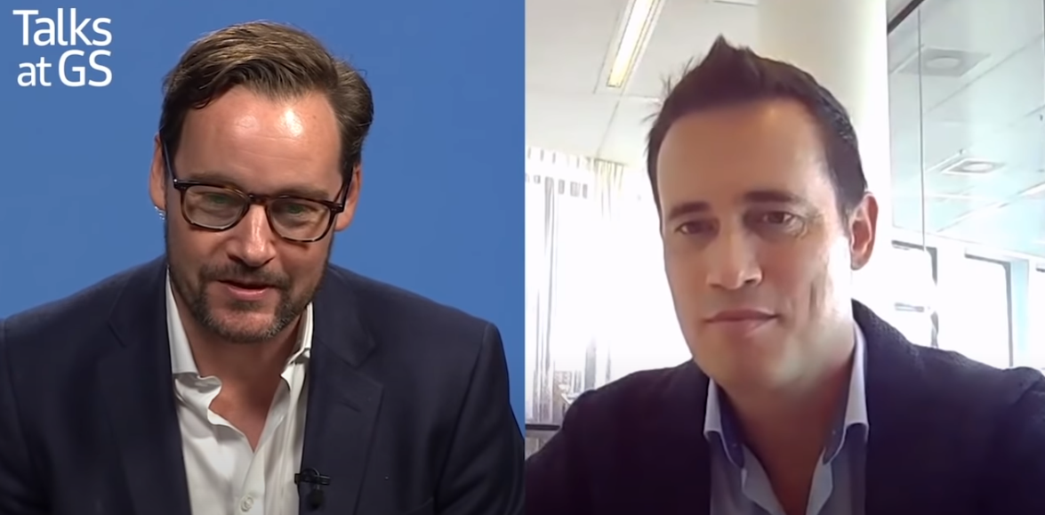
Jitse Groen, CEO of TakeAway.com
https://www.youtube.com/watch?v=Hkwgm28xte0

Slide 3
Contents
Organization growth
Productization
Organizational Structures
Organizational Variability
Legal Forms
Venture Capital
Notes:
3

Slide 4
Growth phases
Phase 1
Startup
Phase 2
Survival
Phase 3
Success
Phase 4
Expansion
Phase 5
Optimal
Size
Large
Small
Age of the organisation
Young
Grown
From: Churchill, N.C. en V.L. Lewis (1983), The five stages of small business growth, Harvard Business review, May-June, pp 30-50.

Slide 5
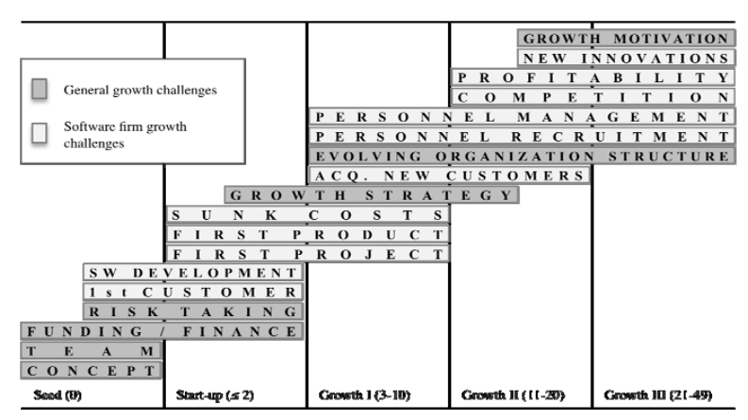
Growth Challenges

Slide 6
Characteristics of phases
Startup: first release, first customers, arranging company
Survival: second release, getting more customers, hiring first employee, create cashflow
Success: more customers, exposure in market
Expansion: redefining the company, hiring personnel, internationalization, company exit strategy
Optimal: customer satisfaction
Most UtrechtInc companies
Olery.com, Oddity, YourNextConcepts
Channable, Relay42, BleuConic,
TakeAway, Adyen, Mollie, Planon, Afas
TomTom, Centric, Booking, Exact, Unit4, GX

Slide 7
Contents
Organization growth
Productization
Organizational Structures
Organizational Variability
Legal Forms
Venture Capital
Notes:
7

Slide 8
Towards product organization
Product Organization
No Product Organization
Customized Standardized

Slide 9
Productization process
6a:
Customizable product
1: Independent projects
2: Reuse across projects
3:
Product recognition
4:
Product basis
5:
Product Platform
6b:
Standard product

Slide 10
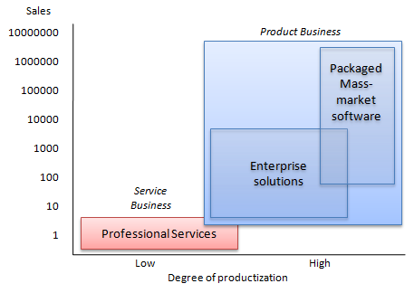
Productization (2)
Two end stages:
For some software there is a need for customization in order to integrate software in a customer-specific situation
“Degree of productization”
(Hietala et al., 2004)
- Product market
- Concepts
- Benefits
- Positioning
- Selling
- Marketing
Degree of standardization
adopted from Hoch et al., 1999

Slide 11
Project Portfolio
Customer Project 1
Customer Project 2
Customer Project 3
Customer Project 4
Software
Custom features
Software
Custom features
Software
Custom features
Software
Custom features
Maintenance
Maintenance
Maintenance
Delivery
Maintenance
Delivery
Delivery
Requirements Engineering
Delivery
Requirements Engineering
Requirements Engineering
Requirements Engineering
Stage 1: Independent projects
Independent relations between projects.
Projects differ in budget, technology, and functionality

Slide 12
Productization process
6a:
Customizable product
1: Independent projects
2: Reuse across projects
3:
Product recognition
4:
Product basis
5:
Product Platform
6b:
Standard product

Slide 13
Project Portfolio
Customer Project 2
Customer Project 4
Customer Project 1
Customer Project 3
Customer Project 4
Software
Custom features
Software
Custom features
Software
Custom features
Software
Custom features
Standard features
Standard features
Standard features
Standard features
Maintenance
Maintenance
Maintenance
Delivery
Maintenance
Delivery
Delivery
Requirements Engineering
Delivery
Requirements Engineering
Requirements Engineering
Requirements Engineering
Stage 2: Reuse across projects
Focus on feature reuse across projects
More custom than standard

Slide 14
Productization process
6a:
Customizable product
1: Independent projects
2: Reuse across projects
3:
Product recognition
4:
Product basis
5:
Product Platform
6b:
Standard product

Slide 15
Product Portfolio
Portfolio management
Customer Project 1
Customer Project 2
Customer Project 3
Customer Project 4
Software
Standard features
Software
Standard features
Software
Standard features
Software
Standard features
Custom features
Custom features
Custom features
Custom features
Maintenance
Maintenance
Maintenance
Maintenance
Delivery
Delivery
Delivery
Delivery
Requirements Engineering
Requirements Engineering
Requirements Engineering
Requirements Engineering
Stage 3: Product recognition
Shared features between projects
More standard than custom
Introduction of portfolio management

Slide 16
Productization process
6a:
Customizable product
1: Independent projects
2: Reuse across projects
3:
Product recognition
4:
Product basis
5:
Product Platform
6b:
Standard product

Slide 17
Product Portfolio
Portfolio management
Customer Project 1
Customer Project 2
Customer Project 3
Customer Project 4
Software
Standard features
Software
Standard features
Software
Standard features
Software
Standard features
Product Roadmapping
Custom features
Custom features
Custom features
Custom features
Maintenance
Maintenance
Maintenance
Maintenance
Delivery
Delivery
Delivery
Delivery
Requirements Engineering
Requirements Engineering
Requirements Engineering
Requirements Engineering
Stage 4: Product basis
Generic product platform
Introduction of product roadmapping
Customer specific maintenance

Slide 18
Productization process
6a:
Customizable product
1: Independent projects
2: Reuse across projects
3:
Product recognition
4:
Product basis
5:
Product Platform
6b:
Standard product

Slide 19
Product Portfolio
Portfolio management
Customer Project 1
Customer Project 2
Customer Project 3
Customer Project 4
Software
Standard features
Software
Standard features
Software
Standard features
Software
Standard features
Product Roadmapping
Custom features
Custom features
Custom features
Custom features
Releases
Releases
Releases
Releases
Delivery
Delivery
Delivery
Delivery
Delivery
Customer Requirements
Customer Requirements
Customer Requirements
Customer Requirements
Requirements
Management
Stage 5: Product platform
Increasing generic product platform
Introduction of requirements management
Requirements gathering based on market trends
Event based customized releases per customer

Slide 20
Productization process
6a:
Customizable product
1: Independent projects
2: Reuse across projects
3:
Product recognition
4:
Product basis
5:
Product Platform
6b:
Standard product

Slide 21
Product Portfolio
Portfolio management
Customer Project 1
Customer Project 2
Customer Project 3
Customer Project 4
Software
Standard features
Software
Standard features
Software
Standard features
Software
Standard features
Product Roadmapping
Custom features
Custom features
Custom features
Custom features
Releases
Releases
Releases
Releases
Release Planning
Launch & delivery
Launch & delivery
Launch & delivery
Launch & delivery
Market Requirements
Market Requirements
Market Requirements
Market Requirements
Requirements
Management
Stage 6a: Customizable product software: Enterprise Application
One standard product with small additional customized layer
Introduction of release planning
Structured standardized releases
Customer requests are handled as market requirements
Product software aiming at selling services

Slide 22
Productization process
6a:
Customizable product
1: Independent projects
2: Reuse across projects
3:
Product recognition
4:
Product basis
5:
Product Platform
6b:
Standard product
Notes:
22

Slide 23
Product Portfolio
Portfolio management
Market Product
Customer Project 1
Customer Project 2
Customer Project 3
Customer Project 4
Product
Standard features
Product
Standard features
Product
Standard features
Product
Standard features
Product Roadmapping
Releases
Releases
Releases
Releases
Release Planning
Launch & delivery
Launch & delivery
Launch & delivery
Launch & delivery
Market Requirements
Market Requirements
Market Requirements
Market Requirements
Requirements
Management
Stage 6b: Standard product
One generic product for all customers and build for a specific market
Introduction of release planning
Structured standardized releases
Software is completely configurable
Product software aiming at selling licenses

Slide 24
Productization process
6a:
Customizable product
1: Independent projects
2: Reuse across projects
3:
Product recognition
4:
Product basis
5:
Product Platform
6b:
Standard product

Slide 25
Contents
Organization growth
Productization
Organizational Structures
Organizational Variability
Legal Forms
Venture Capital
Notes:
25

Slide 26
Organisational structures
Organisational structures because of
Growing organisations need functional specialists
Management has limits in numbers
Categories:
F: Functional
HRM, Development, Sales, Marketing, …
P: Product
ERP, Middleware, BIS, Localizations, …
M: Market
Large accounts, SME, Public, Banking and Insurers, …
G: Geografic
Benelux, Nordic, UK, France, …

Slide 27
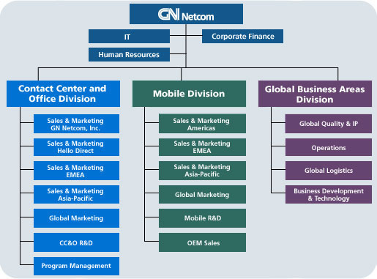
Structuring a company

Slide 28
Standard F-structure
Board
R&D
Marketing
Sales
Services
Support

Slide 29
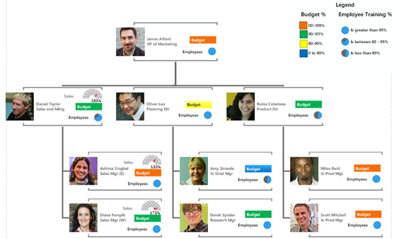
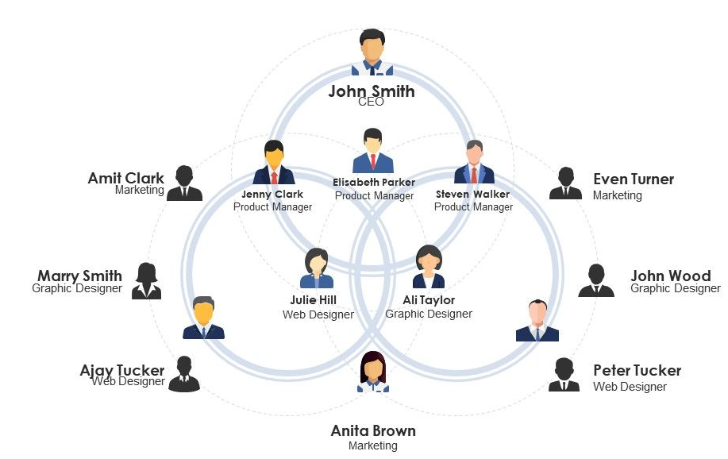
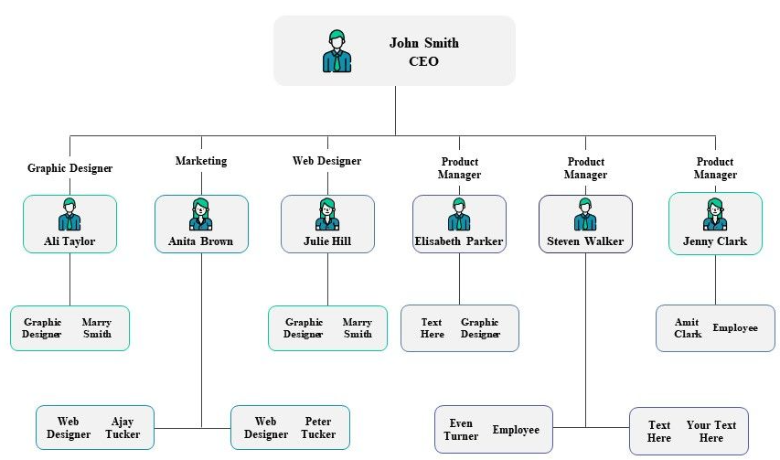
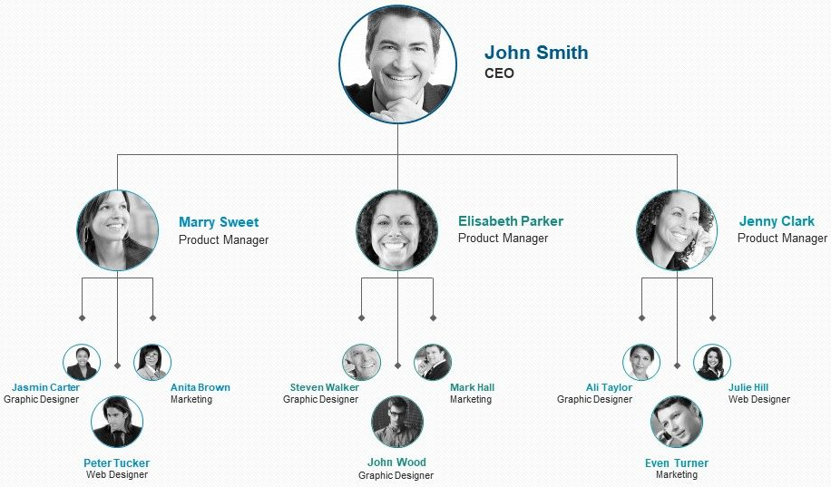
Other examples

Slide 30
F-structure from the top
Board
R&D
Marketing
Sales
Services
Support
WM
P2

Slide 31
Internal Organization
Board
-
-
+
+
+
R&D
Marketing
Sales
Services
Support
P1
P2
P3
Σ
Σ
Profit:
+
-

Slide 32
Investment and profits
Board
-
-
+
+
+
R&D
Marketing
Sales
Services
Support
Σ
Σ
Profit:
+
-

Slide 33
Substructures
Board
R&D
Marketing
Sales
Services
Support
P-structure
Generic,
P-structure
P-structure
P-structure
P-structure
G-structure
M-structure

Slide 34
P-type for R&D
R&D
mgr
Product Management
Architecture Board
ERP
Middle
ware
BIS
Quality & Delivery
R&D departments are responsible for a product line
Product Management:
Functional responsibility
Liaison with Marketing
Architecture Board
Technical responsibility
Interfacing of products

Slide 35
P-type for R&D
R&D
mgr
Product Management
Architecture Board
Product 1
Product 2
Product 3
Quality & Delivery
R&D departments are responsible for a product line
Product Management:
Functional responsibility
Liaison with Marketing
Architecture Board
Technical responsibility
Interfacing of products
Quality and Delivery:
Generic configuration management
Testing and quality management
Documentation and translation
Notes:
35

Slide 36
Ownership R&D
Development
mgr
Product Mgr
Architect
Team1
Team2
Team3
…
Team has all roles for development of a product:
Design
Realisation
Testing
Configuration Management
Documentation
Architecture ~ Organisational structure (Conway’s law)
Notes:
36

Slide 37
Ownership R&D
Development
mgr
Product Mgr
Architect
Team1
Team2
Team3
…
Team has all roles for development of a product:
Design
Realisation
Testing
Configuration Management
Documentation
Architecture ~ Organisational structure (law of Conway)

Slide 38
M-type for Sales
Sales
mgr
CRM
Contracts
Large Accounts
SME
Banking & Insurance
…
Centralized customer relationship management
Relationship with Support
Contracts require legal support
Large international companies have first a G-type for Sales
Notes:
38

Slide 39
M-type for Sales
Sales
mgr
CRM
Contracts
Large Accounts
SME
Banking & Insurers
…
Central Customer Relationship Management
Relationship with Support
Contracts require legal support
In case of a contractual commitment on an extension of the standard product (time or content) an agreement of R&D is required
Large international companies have first a G-type for Sales

Slide 40
Other departments
Marketing
Always for the whole company
Uniform market presentation
Market launches
Customer reference stories
Services
Implementation, Technical installation, Training, Customizations, Organizational improvement
Pool of consultants
P-, G-, M-type
Support
1st line (questions): Generic for all products
2nd line (simpel defects): P-type
3rd line (complex defects): performed by R&D on standard product; or by Services on customizations
Notes:
40

Slide 41


Slide 42
Contents
Organization growth
Productization
Organizational Structures
Organizational Variability
Legal Forms
Venture Capital
Notes:
42

Slide 43
Legal forms
Eenmanszaak (Sole proprietorship, ZZP)
Vennootschap Onder Firma (General partnership, VOF)
Besloten Vennootschap (Corporation, Private partnership, BV)
Naamloze Vennootschap (Limited liability corporation, NV)
Maatschap (Partnership)
Vereniging (Association)
Stichting (Foundation)
Commanditaire Vennootschap (Sleeping company, CV)
Differences in ownership, taxation and liability
Chamber of Commerce has all information needed: www.kvk.nl
Choice instrument

Slide 44
Legal Forms
Legal form | Legal entity / Liability | Taxes
Sole proprietorship One owner (Eenmanszaak) | No legal entity Owner is liable | Income tax VAT
General partnership A company with two or more persons (partners) (Vennootschap onder firma, VOF) | No legal entity Partners are liable | Income tax on partner share of profit VAT
Partnership For specific sectors: medical, consultancy, legal. (Maatschap) | No legal entity Partners are liable for debts and actions | Partners: Income tax on share of profit VAT for Partnership
Based on Netherlands Law. For other countries there are deviations.

Slide 45
Legal Forms (2)
Legal form | Legal entity / Liability | Taxes
Corporation Limited liability (Besloten vennootschap, BV) | Legal entity Corporation is liable for debts | Corporation tax on profit Wealth tax on capital VAT
Limited liability corporation Listed on stock market after Initial Public Offering (IPO) (Naamloze vennootschap, NV) | Legal entity Corporation is liable for debts | Corporation tax on profit VAT
Association or Foundation An association or foundation runs a company | Legal entity Association or foundation is liable for debts | Corporation tax on profit VAT
Based on Netherlands Law. For other countries there are deviations.

Slide 46
Sharing company ownership
The number of shares per shareholder is based upon the explicit and implicit assets that are brought together in the startup:
Knowledge
Finances
Resources
Products
Network
Etc.
All have to be capitalized at a rate acceptable for all shareholders
Notes:
46

Slide 47
Value of a company
The value of a company is based on the value of:
Products and services
Customers and quality of customers
Financial situation: cash and liabilities
Resources
Employees
Etc.
Company values are usually determined through a comparison with other similar company
Notes:
47

Slide 48
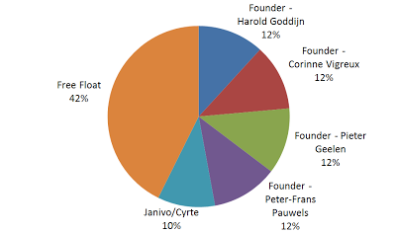
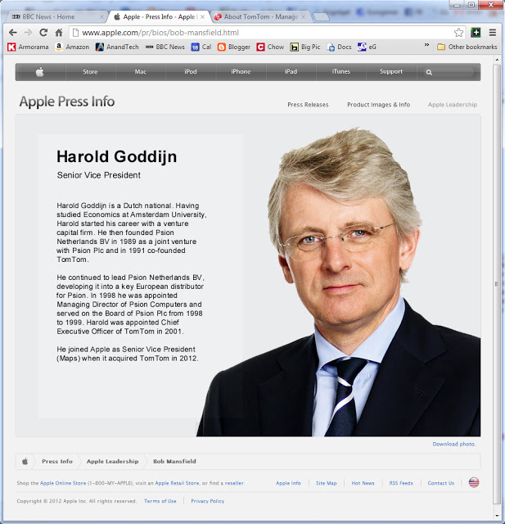
Who owns TomTom?

Slide 49
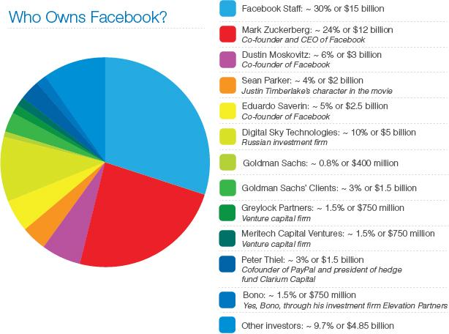

Slide 50
Value growth
Start
After x years
3
3
Sh1
Sh2
Sh3
Sh4
2
2
Sh1
Sh2
Sh3
Sh4
Share value (in 1€)
Share value (in 1€)
1
1
5
10
15
5
10
15
# shares (in 1000)
# shares (in 1000)
Value growth due to more assets: product functionality, customers, employees, money, facilities and infrastructure

Slide 51
Shareholder changes
Year n
Year n
3
Sh1
Sh2
Sh3
Sh4
3
Sh1
Sh5
Sh6
Sh3
Sh4
Sh7
2
2
Share value (in 1€)
Share value (in 1€)
1
1
5
10
15
5
10
15
20
# shares (in 1000)
# shares (in 1000)
Shareholder changes due to: departure of shareholder, investments, venture capital, acquisition other company

Slide 52
Shareholder arrangements
Summation of shareholder amounts is the nominal value of the company
Round it into a nice amount of money
Price per share is then determined on 5, 8, 10, or 16 eurocent
The number of shares for each shareholder
At the start this division of ownership has to be established, and recorded in the company charter documents.
It can change in the course of the company life-time
Membership of the Board of the company
Supervisory Board
Meetings of the Board and the Supervisory Board
Reporting
Arrangements for the shares and concrete assets in case of:
Company is terminated by the shareholders
Company goes bankrupt
A shareholder wants to withdraw, or wants to sell (part of) the shares
A new shareholder wants to join the company
The company is taken over by another company
These issues are usually simpler to arrange that many people think
Standard arrangements are available.
Notes:
52

Slide 53
Legal forms of phases
Startup: Sole proprietor, general partnership
Survival: Corporation
Success: Corporation, Holding structure, Joint ventures
Expansion: Public company, Multi-national
Optimal: Restructuring for financial optimization (tax, offices)
----
For Consultancy: Partnership
Notes:
53

Slide 54
Contents
Organization growth
Productization
Organizational Structures
Organizational Variability
Legal Forms
Venture Capital
Notes:
54

Slide 55
When external financing?
YES:
Packaging existing product
Marketing/sales plan
Market Launch of proven product
Extension sales infrastructure
Spin-off product
…
NO:
Paying debts
Salary increase
Facilities, cars…
Concept development
…
Notes:
55

Slide 56
SW Business Start-Up Lifecycle
Concept
Establish-ment of company
Seed financing
Design and Develop-ment
“Go live”
Corporate organisa-tion
Public offering
Acquis- tion led growth
Develop business concepts
Make formal agreements / establish private company
Establish organisation
Develop strategies and business plans
Raise start-up capital
Build the technical solutions
Enter alliances and/or distribution agree-ments
Go online first time
Marketing
Monitor and measure
Both organic growth and growth through mergers
Product develop-ment
Organisational changes
Building business cases, prospects
More formal require-ments
Mergers and acquisi-tions
Utrecht, January 12th , 2011
Notes:
56

Slide 57
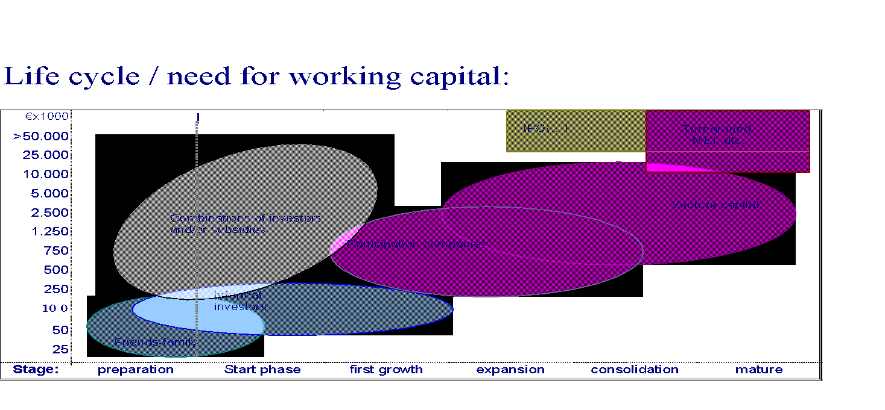
Life cycle / need for working capital
B2B Early Stage
Notes:
57

Slide 58
The VC Life Cycle
Submit business plan
Preliminary assessment
Meet the people
Light due diligence
Term sheet
Heavy due diligence
Investment memorandum
Commitment letter
Shareholder’s agreement
Grow the company
Exit

Slide 59
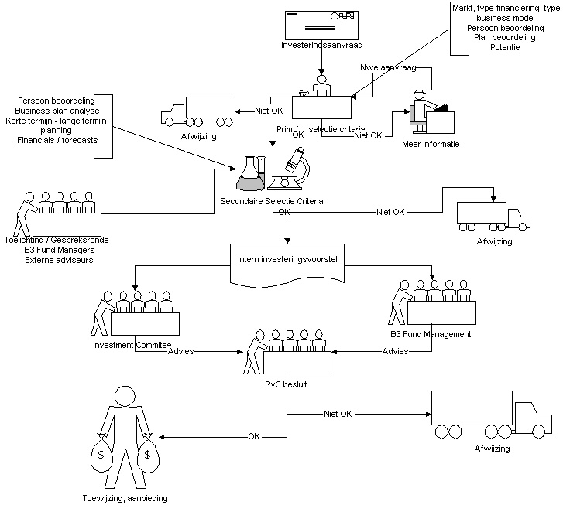
Process: Investment selection & decision making
Utrecht, January 12th , 2011

Slide 60
Value determination - Selection Criteria
 | Strong Manage- ment | Attractive Market | Application Product Hot | Solution Credibility Gap | First class Customers- Qualified Pipeline | Product/ Release Flexible | Strong Profit Acceleration | Success References in Market
Participation 1 |  |  |  |  |  |  |  | Knowledge-network/ aging
Participation 2 |  |  |  |  |  |  |  | EC focus on Environment TomTom
Participation 3 |  |  |  |  |  |  |  | MS Navision X-Hive
Participation 4 |  |  |  |  |  |  |  | Google
Participation 5 |  |  |  |  |  |  |  | Yunoo

Slide 61
Valuation fundamentals
Assets and Liabilities (Activa/Passiva)
Going Concern
Price/Earnings Ratio (PE)
Discounted Cash flow (DCF)
Exit Strategy
Utrecht, January 12th , 2011
Notes:
61

Slide 62
Capital Markets Playing Field
Phase I
Phase II
Phase III
Knowledge
Acquisition
Concept
Investigation
Basic
Design
Prototype
Building
Market
Entry
Manufacturing
Ramp-up
Government Programs
Public Issues
Commercial Banks
Non-Financial Corporations
Seed Funds
Venture Capital Funds
Wealthy Family Funds
Private Investors
Faminly and Friends
Personal Savings
62

Slide 63
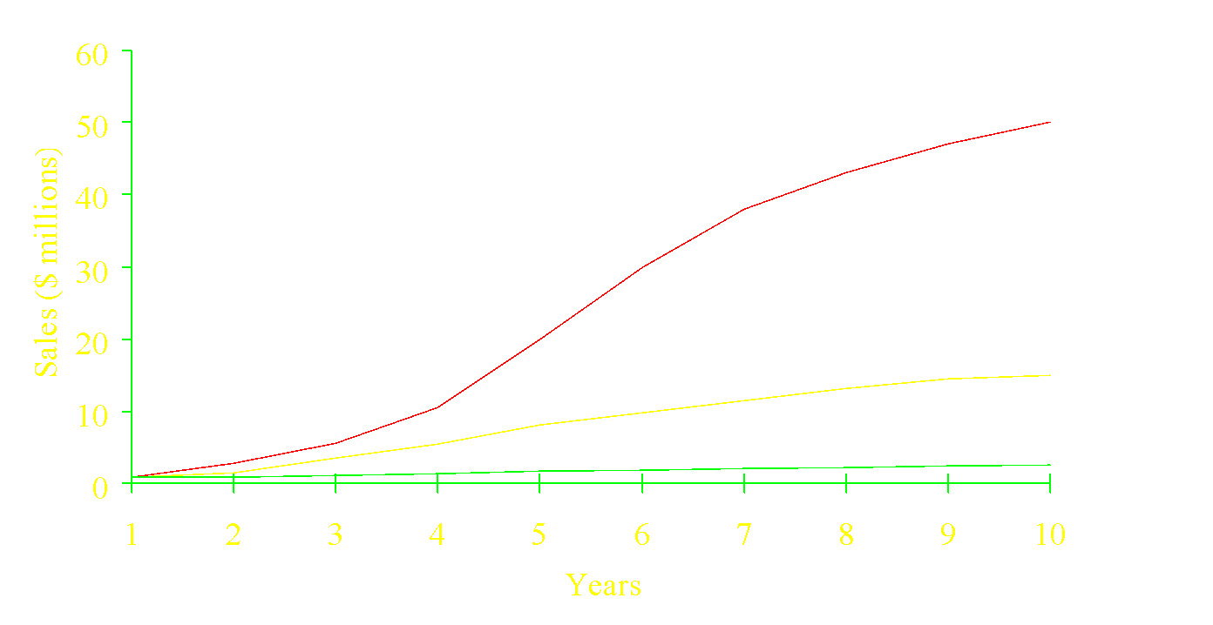
Typical SME Growth Profiles
High-Growth Firm
Moderate-Growth Firm
VC Prospects
Low-Growth Firm

Slide 64
VC Investment Criteria
Exponential growth potential
Attractive industry
Sustainable advantage platform
Excellent team “execution”
Owners receptive to involvement of outsiders
Owners willing to share the wealth creation
Credible exit alternatives (4-7 years out)

Slide 65
The Ingredients- Good CEO
Good CEO is the most critical element
Best is “been there and done that”
Has specific domain experience/expertise
“Knows what he/she doesn’t know & locates resources to fill gaps.”
Shows “fire in the belly”
Recognizes urgency-revenue generation/ burn rate
Knows the difference between being an employee and being a shareholder

Slide 66
The Ingredients-Strong Management Team
Characteristics Include:
Honesty/Integrity/Competence/Discipline
Have specific domain experience
Ability to self-assess
Motivated
“Fire in the belly”
Plans and communicates effectively
Develops appropriate MIS
Caveat-beware the “family ties”

Slide 67
The Ingredients-Technology/Core Competence
Ability to define and enunciate what it is
Ability to relate core technology-/competence to a variety of significant market applications-(must be balanced by focus)
Strong “in house” R&D capability with the mechanisms to fund it.
Equity/loans
Customer Pays (direct or through margins)

Slide 68
The Ingredients-The Business Model
Implies having a well defined business model that says, “I know who my customers are, what they need, how I will meet their needs, how I will reach them, how I will service them, how I will continue to best my competition and how I will make money.
Avoid “if we build it they will come!”

Slide 69
Ingredients-The Value Proposition
Why will/do our customers buy or product?
Ease the Pain
Improve Revenue/ Productivity/Profitability

Slide 70
The Ingredients-The Strategic Alliance
A “must” for most emerging companies
distribution
product development (perhaps)
Can accelerate success or hasten demise

Slide 71
Main lessons
Keep your focus on goals, product and market
Learn by doing
Lots of advise on web
Some people do not fit in founding stage; others don’t fit in scale-up
You will get in trouble with your friends; but focus with flexibility is essential
Avoid family ties: circles within circles is harmful
Questions?

